Slide 1
CHAPTER 5 - COUNTING

Slide 2
Choose a 6-character password: ******
* can be 0..9, a..z, A..Z, #,@, … (assume in total 100)
How many possible passwords ?

Slide 3
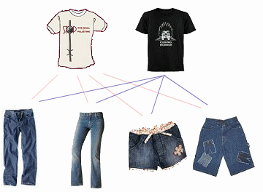
Product rule
Task = task 1 AND task 2
2
×
4
Task 1: choose one
Task 2: choose one

Slide 4
Product rule
THE PRODUCT RULE
Task = task1 ➔ task 2 ➔ task 3 ➔ … ➔ task k
task 1: n1 ways
task 2: n2 ways
…
Task k: nk ways
----------------------------
Product rule: n1.n2…nk ways to do the task

Slide 5
Product rule
Example. A new company with just two employees, No and Mon, rents a ﬂoor of a building with 12 ofﬁces. How many ways are there to assign different ofﬁces to these two employees?
➔ 2 task2: 12. 11
Example. How many different bit strings of length seven are there?
➔ 7 tasks: 2.2.2.2.2.2.2 =2⁷

Slide 6
How many functions are there from {a, b, c} to {1, 2, 3, 4, 5} ? How many one-to-one functions?
function
Input
Output
A •
B •
C •
• 1
• 2
• 3
• 4
• 5

Slide 7
Exercises
1/ If there are 5 multiple-choice questions on an exam, each having four possible answers, how many different sequences of answers are there?
2/ In how many ways can a teacher seat 5 girls and 3 boys in a row seats if a boy must be seated in the first and a girl in the last seat?

Slide 8
Exercises
A = {1, 2, 3, 4, 5, 6}
a. How many subsets of A can be constructed?
b. How many subsets of A that contain 1?
c. How many subsets neither contain 3 nor 4?

Slide 9
The principle of Inclusion-exclusion
|A∪B| = |A| + |B| - |A∩B|
• a
• f
A
• b
• d
B
• e
• c
| A∪B | = |A| + |B| - |A∩B| = 4 + 3 - 1

Slide 10
The principle of Inclusion-exclusion
How many bit strings of length eight either start with a 1 bit or end with the two bits 00?
Result = 2⁷ + 2⁶ - 2⁵
1*******
1*****00
******00
2⁷ ways
2⁶ ways
2⁵ ways

Slide 11
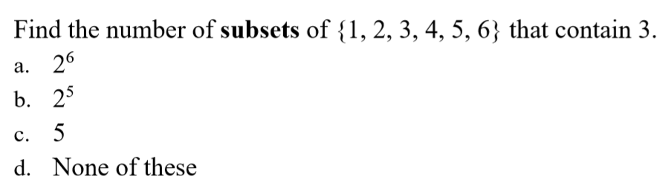
Quiz
✓

Slide 12
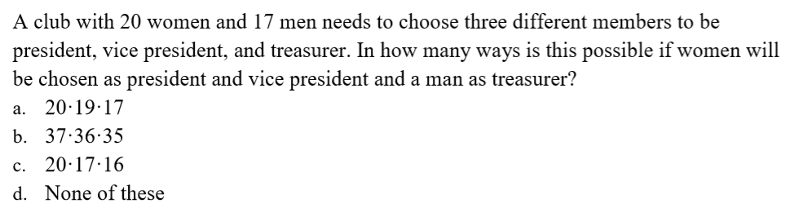
✓

Slide 13
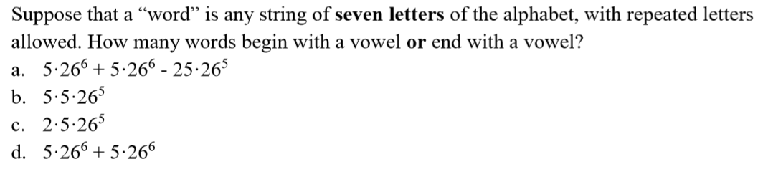
✓

Slide 14
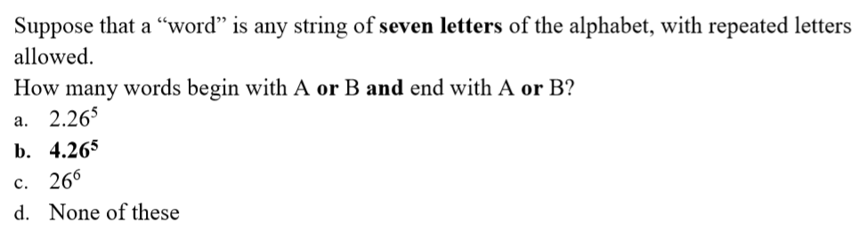
✓

Slide 15
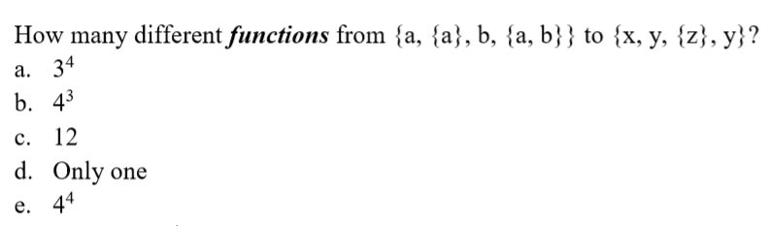
✓

Slide 16
Answer: 8
Answer: 6.2⁶⁵

Slide 17
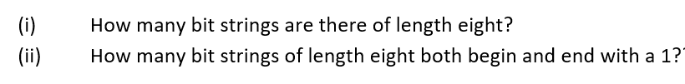
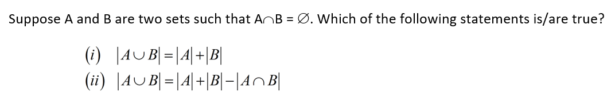
Answer: (i) 2⁸ (ii) 2⁶
Answer: both

Slide 18
A push-button door lock requires you to enter a code to open. The lock has ﬁve buttons, numbered 1, 2, 3, 4, 5. If a code consists of a sequence of four digits, with repeated numbers allowed, how many codes are possible?
Answer: 5⁴

Slide 19
THANKS

